Slide 1


Big Data Algorithms
with Twitter Algebird +
Spark Streaming
基于Twitter Algebird 和 Spark Streaming 的大规模流式数据处理算法
This is how you would solve it for small data.
Ryan Braley
Chief Architect | Traintracks.io
首席架构师 | Traintracks.io 大数据分析平台

Slide 2

You are an engineer at a video-sharing website company.
你是一个在视频分享网站工作的工程师。

Slide 3

Task: Calculate the number of unique users in the views of all videos…
任务: 对于所有观看了视频的用户，统计去重后的用户数...
…in real time.
…如何实时统计?

Slide 4

SELECT COUNT(DISTINCT USER_ID) FROM VIEWS;
Small data, small problems
数据量小的时候，这个问题很容易解决
Big data?
数据量非常大？
1 billion users. 1 PetaByte. Slow.
十亿用户，PB 级别数据，传统的解决方案将会很慢

Slide 5
What if I told you that we could solve this same problem with 98% accuracy with only 1.5kb of memory?
如果我告诉你只需使用 1.5 kb 的内存，就可以将答案的准确率控制在 98% 左右，你是否会像我一样感到无比的兴奋?

Slide 6
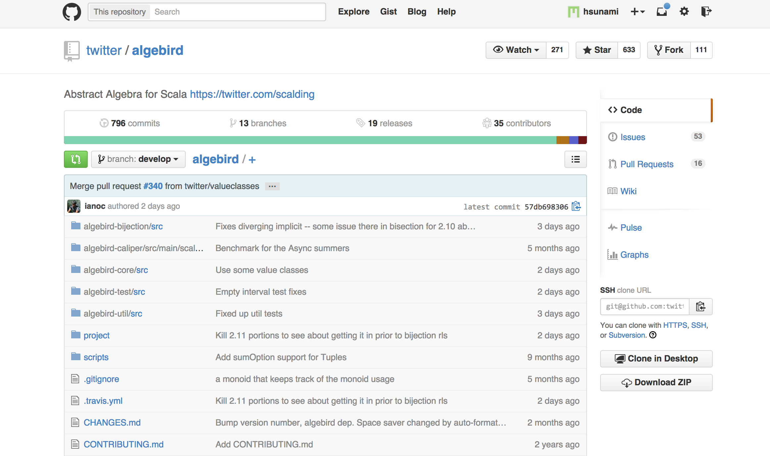
Approximation Algorithms
with Twitter Algebird.
当近似算法遇见 Twitter Algebird。

Slide 7
Approximation algorithms 近似算法
1. Usually based on hashing
通常基于哈希表
2. Performance guarantee and provable accuracy
良好的性能与可证明的准确性
3. Many are based on Monoids
很多基于 Monoids

Slide 8
Monoids
Integers:
(1 + 2) + 3 = 1 + (2 + 3)
2. Strings:
("spark" + "meetup") + "beijing" = "spark" + ("meetup" + "beijing")
3. Set union:
([“jeff”, “hsu”] u [“ryan”, “braley”]) u [“nils”, “pihl"] =
[“jeff”, “hsu”] u ([“ryan”, “braley”] u [“nils”, “pihl”])

Slide 9
Monoids are great because they are associative and parallelizable.
Monoids 是极好的因为它具有结合律和并发性。

Slide 10
Approximation algorithms based on monoids have low memory footprint and are inherently parallelizable.
基于Monoids 的近似算法具有低内存占用且天生支持并行化的特点。

Slide 11



Algebird

Slide 12

Calculate the number of unique users in the views of all videos…
统计 views 中去重后的用户数
…in real time, with the HyperLogLog algorithm.
利用 HyperLogLog 算法来实时计算

Slide 13
HyperLogLog
1. Similar to an approximate set
与近似集合相似
2. Calculates approximation of cardinality of the set.
近似计算集合的基数
3. Can calculate with predictable error bounds
可预见的误差范围
98% accuracy with only 1.5kb of memory.
只需 1.5KB 的内存，98%的准确率。

Slide 14

Task #2: Calculate the number of views per unique users of all videos…
任务2：计算去重后每个用户观看的视频的次数...
…in real time, with the Count-Min Sketch algorithm.
…使用 Count-Min Sketch 算法实时计算。

Slide 15
Count-Min Sketch
1. Keeps track of frequency of each element in stream
记录一连串数据中每个数据出现的频次
2. Returns an upper bound, but may overestimate
具有上限，有可能会过高
3. Similar to a bloom filter
与布隆过滤器类似
x% accuracy with only y-kb of memory.
只需 y kb 内存，拥有 x% 的准确率。

Slide 16

Task #3: Calculate the number of views per video and top 10 videos...
任务3：计算所有视频中观看次数最多的 10 个视频...
…in real time, with the Sketch Map algorithm.
…使用 Sketch Map 算法。

Slide 17
Sketch Map
1. Keeps track of frequency of each element in the stream
记录一连串数据中每个数据出现的频次
2. Returns an upper bound, but may overestimate
具有上限，有可能会过高
3. Similar to a bloom filter
与布隆过滤器类似
4. Includes running list of Top K heavy hitters
能实时获取当前所有元素中最频繁的 K 个
x% accuracy with only y-kb of memory.
只需 y kb 内存，拥有 x% 的准确率。

Slide 18
Demo

Slide 19
In addition to HyperLogLog, Count-min Sketch, and Sketch map…
除了 HyperLogLog, Count-min Sketch 和 Sketch map…
Twitter Algebird offers way more approximation algorithms based on monoids…
Twitter Algebird 还提供了更多基于 monoids 的近似算法...
BloomFilter, ExponentialMA, Moments, MinHash, QTree, TopK, just to name a few.

Slide 20




Algebird
http://github.com/traintracks/sparkstreaming-algebird-algorithms-demo
@Traintracks
ryan@traintracks.io
@TraintracksTeam
facebook.com/traintracks.io
www.traintracks.io
This is how you would solve it for small data.

